Slide 1

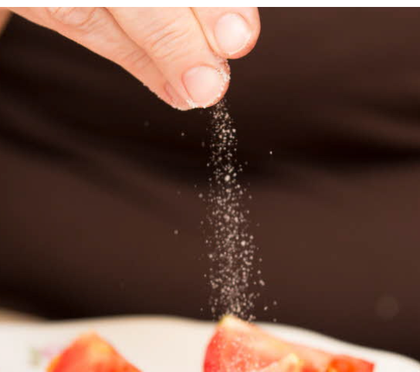
Sample Landscape analysis Sugar & Salt Reduction in Confectionary

Slide 2
Table of Contents
Objective, Scope and Methodology
Overall Observations:
Quick Sneak Peek
Global Activity
IP Trend based on Priority, Application & Publication Year
Geographical Activity- Priority Filings
Salt/Sugar– Application Areas Focused in Patents
Overall Problems Associated with Increased Salt and Sugar Content In Confectionary
Problems & Solutions Associated with Increased Sugar Content
Leading Assignee- Sugar Reduction
Leading Universities/Institutions- Sugar Reduction
Reduced Sugar Products
Problems & Solutions Associated with Increased Salt Content
Leading Assignee- Salt Reduction
Reduced Salt Products
Recommendations by WHO
Appendix-1
Appendix-2
Disclaimer

Slide 3
Project Overview

Slide 4
Scope & Methodology
Specific focus is on method of reducing salt or sugar content while preparation of Confectionary products.

This report includes a Patent Landscape Study for capturing innovation related to reducing Sugar and Salt content in Confectionary. Specific focus is on the method of reducing salt or sugar content while preparation of Confectionary products
Specially highlighted are the problem areas, the currently existing solutions, the emerging trends and the key geographical areas which have played a significant role in the advancement of this industry till date.
We analyzed the data relevant to this domain in order to identify the key geographical areas where the technology growth is much faster than the rest of the world.
The universities and research institutes which have shown active participation in this field and which are working closely with companies in this industry are also identified.
A list of 362 patent references (belonging to unique INPADOC families) were identified as interesting. The patent references were categorized into a detailed taxonomy presented in the subsequent slide.
R
Granted patents and published patent applications Worldwide The analysis is performed on one representative patent member per patent family.

Add title here
/
Keywords and Class based search strategies were formulated and search was performed on patent databases. For market research information is collected from reports published by companies, leading blogs, news articles, Press releases, product websites, etc.


Preliminary screening was done based on title, abstract and claims to identify potentially relevant references. Detailed analysis and categorization was done on the basis of title, abstract and claims for the potentially relevant patents/published applications.


Relevant trends, Insights and Graphs which reflect the current shape of the technology as well as its future path based on the analysis were prepared.


Slide 5
Get to Know?
Our report provides a detailed answer to the following questions:
B
A
C
A

How has the patent activity in this domain evolved from the time of its conception?
D
Who are the upcoming startups with new technologies in the domain?
D


B
Which countries are the most prominent hubs of innovation for this technology?
E
What are the latest technological breakthroughs in this field?
E

F

F
C
Who are the most active players/companies involved in this field and What are the major claims offered by various products?
What are the challenges for the industry?

Slide 6
Quick Sneak Peek
CHALLENGES
EMERGING TECHNOLOGIES
Challenge in obtaining complete profile of food properties, texture analysis and ingredient interactions for optimal reduction of sugar.
Suprasel OneGrain is a unique solution that brings different ingredients together in a new grain of salt. It contains optimal balance of sodium salt, potassium salt and flavor. The flavor brings back the salty taste while masking the negative taste of the potassium salt.
A new technology has been discovered to change the structure of sugar in a bar of milk chocolate so that it
dissolves more quickly on the tongue. As it melts in the
mouth, it delivers a sweet taste faster than normal
sugar, allowing us to use less sugar while providing
an almost identical sweetness.
Long road towards implementation of new labelling regulations as the industry will require time to make a transition.
Companies need to check the relevant regulations as the useof different low sugar/salt alternatives in different product applications will depend on legislative restrictions in the country where the product(s) will be sold
Ingredion’s unique DIAL-IN® Technology can
help to build back the texture and mouthfeel that’s
often lost when reducing sugar, thereby helping to achieve your desired sweetness and texture parameter.
RSSL Service helps to select most appropriate ingredient
solution (sugar replacers) using their extensive knowledge to minimise the impact on product quality ,advising on regulatory constraints and ingredient costs.
FRUITFUNK
Company was established in 2014 and focuses on low sugar healthy fruit based sugar. It has developed a unique production method in which the original fruit’s fibers, minerals and vitamins are maintained that ensures that the natural fructose will be absorbed by the human body at a slower rate and so the blood sugar levels remain stable.
LOW SODIUM BAKERY
Company was established in 2015 and focuses on
Low Sodium breads & treats.
SERVICE PROVIDERS
STARTUPS

Slide 7




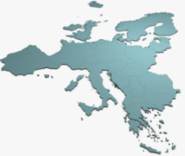
Global Activity
67% patents published in CN.
17% patents published in US
Add title here
Add title here
362 references published worldwide relate to reduction of salt/sugar
6 % patents published in JP.
5 % Patents are PCT filings
Add title here
2 % patents published in KR.
3 % patents published in EP

Slide 8
IP trend based on Priority year, Application year and Publication year
The company Roquette has filed 4 patent references in the year 2016. The patents mostly focus on the low sugar high fibre confectionaries which includes Biscuits and jellies mostly.
Majority of the patent filings during the year 2015-2017 focus on reducing the salt or sugar level in confectionaries for reducing health impacts associated with diabetes, cardiovascular diseases and also on improving off taste & flavors problems
Majority of the patents published during 2016-2017 focus on replacing sugar with sugar alcohols for reducing the level of sugar in confectionary products.

Slide 9
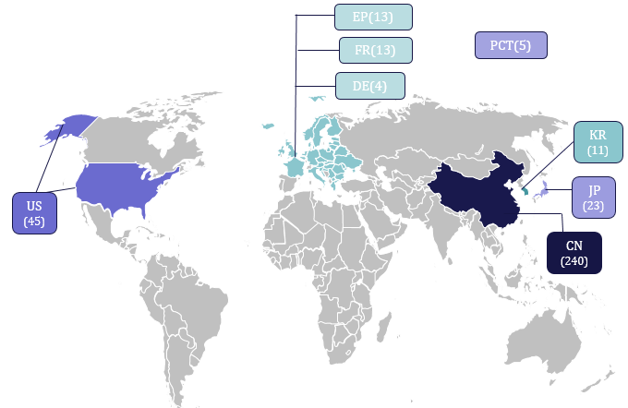
Geographical Activity- Priority Filings
The highlighted box represents universities with priority filing in China
# Please note that graph was generated using one representative member per patent family.
Back to Slide

Slide 10
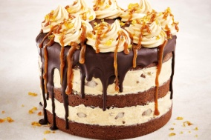



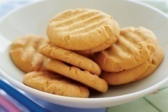
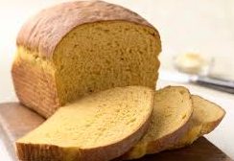
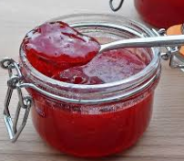
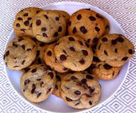
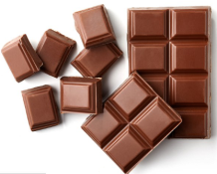
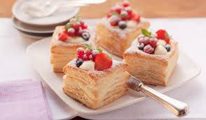
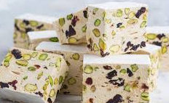
Salt/Sugar– Application Areas Focused in Patents
Sugar/Salt Reduction in Confectionary
Candy
Cake
(Overall 52 Patents)
(Overall 78 Patents)
Biscuits
(Overall 44 Patents)
Bread
(Overall 43 Patents)
Jam
(Overall 21 Patents)
Cookies
Chocolate
Pastry
Nougat
(Overall 27 Patents)
(Overall 10 Patents)
(Overall 9 Patents)
(Overall 4 Patents)

Slide 11



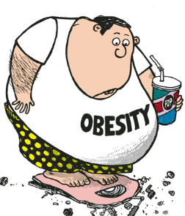


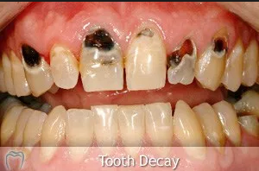
Overall Problems Associated with Increased Salt and Sugar Content In Confectionary
Others include unpleasant aroma, solubility etc
Attributes Distribution
Disturbed Physical Attributes of the product
(151)
Increased Cost of Production of low Salt/Sugar Products
(10)
Other problems include problems like nutritional imbalance, lack of ‘clean label’ substitutes
Cardiovascular
38%
Obesity
14%
21%
Health Impacts
(251)
Others
(21)
Others include pain, fatigue, ulcers etc
9%
8%
Others
Tooth Decay

Slide 12

Increased Sugar Content

Slide 13


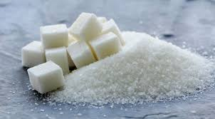

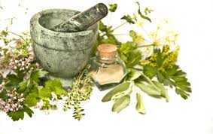
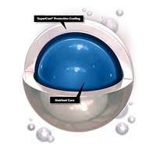
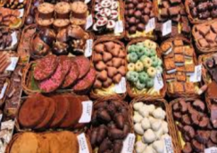


Problems & Solutions Associated with Increased Sugar Content
Solutions Provided
2009
Addition of Honey as a sweetening agent
2012
Replacement of high calorie sugars by low calorie sugar alcohols like xylitol, maltilol etc.
2015
Replacement of sugar by Natural herb like Rhizome dendrobium officinale
2017
Stability increases by sugar-free syrup containing microencapsulated liposoluble natural product
2018
Use of sugar free Novel compositions
Health related
(263)
Diabetes
Hypertension
Attributes related
(121)
Stability
Taste
Production cost
Development cost
Cost
(5)

Slide 14




Leading Assignee- Sugar Reduction
TIANJIN JINSHI PHARMACEUTICAL
JIANGMEN MEIHE FOOD
Mondelez is head to head to Tianjin with same amount of patent activity in this field (5 patent references)
ROQUETTE is head-to-head with JIANGMEN and leads the industry with the same amount of patent activity in this field ( 7 patent references).
Nestle and UHA with 6 patent references
Add title here
Low to high

Slide 15
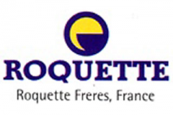
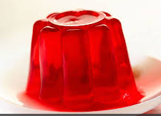
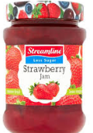
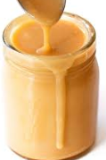
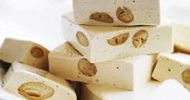
Leading Assignee- Sugar Reduction- ROQUETTE
Problems Focused by the Patent References
18%
INSIGHTS
Roquette has filed 7 patents focusing on low sugar/sugar free confectionary. 4 patents out of these were filed in the year 2016.
Recent patents filed in the year 2016 (WO2018033680A1 & WO2018033679A1) from the company focus on solving texture & appearance related problems by replacing sugar with fiber type malto-oligosaccharides which reduces the sugar content and also enhances the fiber content & texture.
18%
Appearance
19%
Texture
Diabetes
18%
18%
Stability
Obesity
Solutions provided in patents
Replaced sugar with sugar alcohols like xylitol, saccharine, aspartame, acesulfame (2012).
Products Focused
Replacement of sucrose with sweetening bulking agents like branched maltodextrins in combination with at least one polyol (2007).
Jam
Caramel
Nougat
Replacement of sugar with monodisperse maltodextrins or fructooligosaccharides (2008).
Jelly

Slide 16

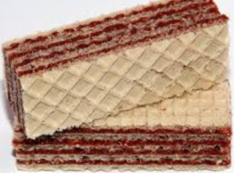

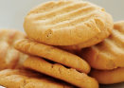

Leading Assignee- Sugar Reduction- NESTLE
Taste Associated Problems:
Bitter after tastes and off-flavors of the the low sugar sweeteners
INSIGHTS
Nestle has filed 6 patents focusing on low sugar/sugar free confectionary.
Recent patents filed in the year 2016 from the company mostly focus on solving problems associated with flexibility, bitter taste and usage of non clean label sugar substitutes etc. for the low sugar confectionary products.
Recent publication (WO2018100059A1) by the company focuses on using amorphous particles which are clean label when used as sugar replacers in confectionary
Problems Focused by the Patent References
Taste
(43%)
Others
(29%)
Texture
(28%)
Other Problems:
High Cost required for the production of the low sugar sweeteners.
Inability to manufacture “Clean label’ sugar.
Texture Associated Problems:
Inability to maintain crispy texture
Loss of flexibility which resists the food to form shapes/roll
Increased Viscosity of the sugar replaced product
Solutions provided in patents
Products Focused
Replacement of sugar with monodisperse maltodextrins or fructooligosaccharides (2008).
Use of three stage baking process which involves a pre baking step leading to a product with high moisture content with high flexibility (2007).
Wafer
Chocolates
Biscuits
Jelly
Use of non digestible fibers of low calorie content which increases the solids content and thereby flexibility of the low sugar product is maintained. (2016).

Slide 17
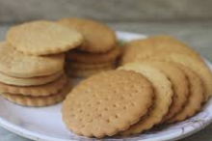
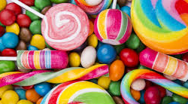
Leading Assignee- Sugar Reduction- JIANGMEN MEIHE FOOD
JIANGMEN MEIHE FOOD
INSIGHTS
Jiangmen has filed 7 patents focusing on low sugar/sugar free confectionary. Interestingly, all these patents were filed in the year 2015 with Chinese priority. These focus on confectionary products like biscuits and their method of preparation.
Problems Focused by the Patent References
Tooth Decay
(38%)
Diabetes
(12%)
Products Focused
Other Health Disorders
(2%)
Obesity (44%)
Biscuits
Candy
Replacing the cane sugar present in confectionaries with other low sugar sweetening agents (2015)
Candy
Replaced sugar with natural herb. (2015)

Slide 18





Leading Universities/Institutions- Sugar Reduction
Shanghai Institute of Technology
(8 patent references)
University Bohai
(3 patent references)
Bohai University (BU) is a comprehensive university at Liaoning provincial level. Patent references by the institute focus mostly on sugar less moon cakes & biscuits.
The Shanghai Institute of Technology is a high-leveled, multi-disciplined, application-oriented full-time tertiary education institution in Shanghai, People's Republic of China. Patent references by the institute focus mostly on sucrose free cookies.
GUILIN YUXIN AGRICULTURAL TECH
(4 patent references)
University Fujian Agriculture & Forestry
(3 patent references)
Patent references by the institute focus mostly on Sugar free jams & jellies.
Bohai University (BU) is a comprehensive university at Liaoning provincial level. Patent references by the institute focus mostly on sugar less moon cakes & biscuits.
Anhui Normal University
(4 patent references)
University Tianjin Science & Technology
(3 patent references)
Anhui Normal University is an institution of higher learning in Wuhu, Anhui Province of the People's Republic of China. Patent references by the institute focus mostly on low sugar pastry & cakes.
Tianjin University of Science & Technology is a university in Tianjin, China under the municipal government.. Patent references by the institute focus mostly on sugar free candy & biscuits.

Slide 19
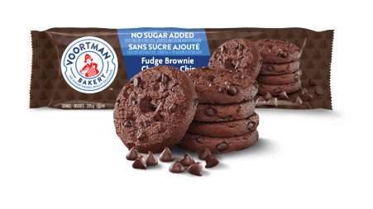
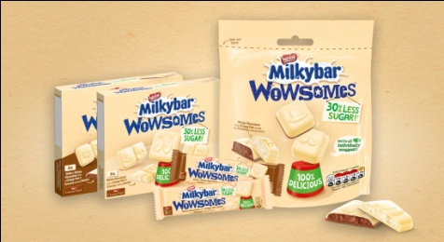
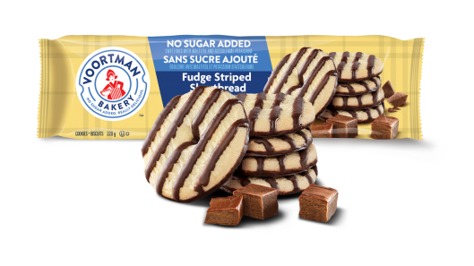
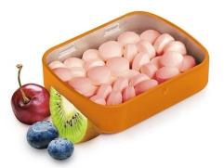
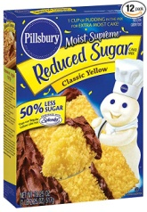
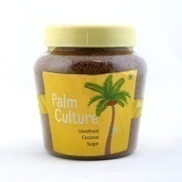
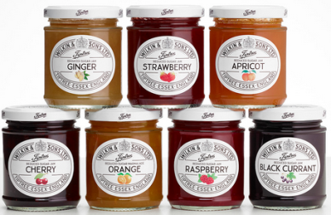
Reduced Sugar Products
Milkybar Wowsomes
Advantage:
1. 30% less sugar* and no artificial sweeteners
2. Formulated with Nestlé’s patented sugar reduction technology
3. First line of reduced sugar products in 2018.
Products Range
VOORTMAN BAKERY
NESTLE
No Sugar Added Fudge Brownie Chocolate Chip & Fudge Striped Shortbread
Advantage:
1. No high-fructose corn syrup.
ROQUETTE
Pillsbury Moist Supreme Reduced Sugar Classic Yellow Cake Mix
Advantage:
Ideal for diabetics as the sugar content is reduced by half.
Pleasant flavor and moistness
GENERAL MILLS
Sweet’n tasty tutti-frutti mints
Advantage:
Good stability
Sugar-free
Toothfriendly
Well Being Organic
WILKIN AND SONS
Palm Culture - Unrefined Coconut Sugar
Advantage:
Low Glycemic Index
Nutritional superfood which offers more vitamins and minerals than white table sugar.
Less Fructose
Tiptree Reduced Sugar Jams
Advantage:
1. Perfect low sugar preserves

Slide 20
Increased Salt
Content

Slide 21
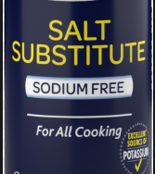
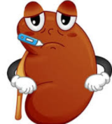
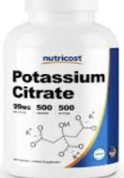
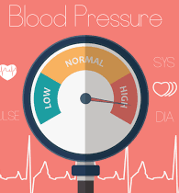
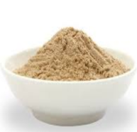
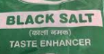
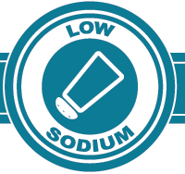
Problems & Solutions Associated with Increased Salt Content
Use of Salt Substitute like Salicornia herbacea powder (2012)
Replacement of NaCl with like monopotassium phosphate, and potassium citrate (2015)
Use of other low sodium salts like KCl and sodium gluconate in addition to NaCl (2006)
Use of Low amount of salt concentration with salty taste enhancers (2008)
Use of salty low sodium novel compositions (2015)
Health related
(41)
Kidney Failure
Hypertension
Attributes related
(30)
Insufficient saltiness, off flavor and taste
Alternation of Appearance and inferior texture

Slide 22




Leading Assignee- Salt Reduction
NESTLE, GENERAL MILLS AND KANEKA have the same amount of patent activity in this field (2 patent references)
Nutek Salt leads the industry with its reduced salt compositions( 4 patent references).
LESAFFRE with 3 patent references
Add title here
Add title here
Add title here
Low to high

Slide 23

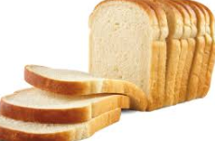
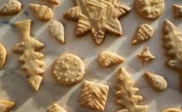

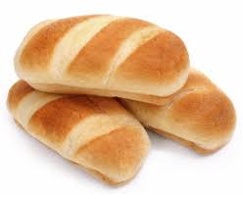

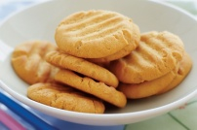
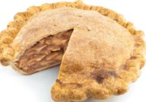

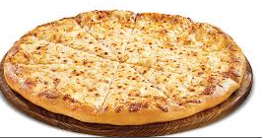
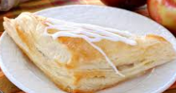
Leading Assignee- Salt Reduction- Problems & Solutions
Problems Focused
Solutions Provided
Products in Use
Cardiovascular & Hypertension
Unsatisfactory taste of low
sodium salts
Costly production method
Use of substitutes like salt modifier, Salty Taste enhancer
Bread Baked Foods
Bland taste, light-colored crust
Volume loss & degradation of appearance
Stickiness, excessive scalability
Replaced NaCl salt with potassium and ammonium salt
Use of Salt Substitute
Buns Bread
Reduced salt composition
Additional low sodium salts like S. herbacea (saltwort), L. japonica (sea tangle), L. chinensis (kukoshi)
Low baking performance and bitter taste of the other low sodium salts.
Hypertension
Biscuits bread Pies
Applying powder particles comprising a starch-based material and a salty tasteant to a surface.
Off flavors and taste
Inferior texture
Top Assignees+ Problem Focused + Solutions Provided + Products in Use

Slide 24
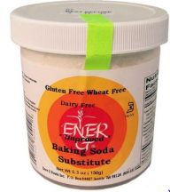
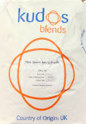
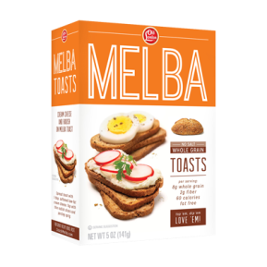



Reduced Salt Products
PELL K™ Low Sodium Baking Powders & Sodium Bicarbonate.
Advantage:
1. Reduce sodium whilst maintaining taste, texture and quality
2. Increases potassium to improve mineral balance for healthier baked cakes
3. Maximises product volume by optimising gas release during mixing, holding and baking stage
4. Customised blends to suit your bakery needs, optimised for your products.
Products Range
ENER-G
KUDOS BLENDS
Ener-G Baking SODA Substitute
Advantage:
1. Good for individuals on Kidney Dialysis who must avoid sodium salts.
2. Create the necessary gas for breads, cakes, muffins etc. to rise
OLD LONDON FOODS
HAIN PURE FOODS
Whole Grain Unsalted Melba Toast
Advantage:
1. No Sodium, No fat, no cholesterol, and great taste
Hain Featherweight Baking Powder
Advantage:
1. Reduce sodium whilst maintaining taste, texture and quality
NUTEK SALT
CLABBER GIRL
Rumford Baking Powder, Reduced Sodium
Advantage:
1. Reduced-sodium baking powder that’s guaranteed to produce light and fluffy cakes, breads, pancakes and more
Salt for Life
Advantage:
1. Sea Salt and Potassium Salt Blend has 75% less sodium vs. regular salt and replaces it with Potassium Salt, a necessary and often under-consumed nutrient

Slide 25

Recommendations by World Health Organisation(WHO)
SUGAR
SALT
WHO recommends a reduced intake of free sugars throughout the lifecourse
For adults: WHO recommends that adults consume less than 5 g (just under a teaspoon) of salt per day


6
1
In both adults and children, WHO recommends reducing the intake of free sugars to less than 10% of total energy intake.
All salt that is consumed should be iodized or “fortified” with iodine, which is essential for healthy brain development in the fetus and young child and optimizing people’s mental function in general.


5
2
WHO suggests a further reduction of the intake of free sugars to below 5% of total energy intake that works out to about 6 teaspoons -- or 25 grams -- of sugar per day.
●

For children: WHO recommends that the recommended maximum intake of salt for adults be adjusted downward for children aged two to 15 years based on their energy requirements relative to those of adults
4
3

Slide 26
Appendix

Slide 27
CPC Class Trend – Salt/Sugar
The Sub class relates to, Vegetable material
The Sub class relates to, bakery products with modified sugar content; Sugar free products
This class relates to treatment, preservation of flour or dough by adding materials
The class relates to food, foodstuff
The class relates to cocoa products.
# Please note that graph was generated using one representative member per patent family.
# Detailed Definitions of the class is provided in Appendix-1
Back to Slide

Slide 28
IPC Class Trend – Salt/Sugar
The Sub class relates to, Vegetable material
The Sub class relates to, treatment of flours by adding carbohydrates.
This class relates to treatment, preservation of flour or dough by adding materials
The class relates to food, foodstuff
The class relates to cocoa products.
# Please note that graph was generated using one representative member per patent family.
# Detailed definition is provided in Appendix-1

Slide 29
Appendix – 1
A23 | Foods or foodstuffs; their treatment, not covered by other classes; Attention is drawn to the following places:C08BPolysaccharides, derivatives thereofC11Animal or vegetable oils, fats, fatty substances or waxesC12Biochemistry, beer, spirits, wine, vinegarC13Sugar industry.
A23G | Cocoa; cocoa products, e.g. chocolate; substitutes for cocoa or cocoa products; confectionery; chewing gum; ice-cream; preparation thereof;
A23G3/00 | Sweetmeats; Confectionery; Marzipan; Coated or filled products(chewing gum A23G4/00)
A23G3/42 | Characterised by the carbohydrates used, e.g. polysaccharides(containing dairy products A23G3/46)
A23G3/38 | Sucrose-free products
A23G3/48 | Containing plants or parts thereof, e.g. fruits, seeds, extracts(containing gums A23G3/42)
A23L | Foods, foodstuffs, or non-alcoholic beverages, not covered by subclasses A21D or A23B to A23J ; their preparation or treatment, e.g. cooking, modification of nutritive qualities, physical treatment(shaping or working, not fully covered by this subclass, A23P);preservation of foods or foodstuffs, in general (preservation of flour or dough for baking A21D)
A23L27/00 | Spices; Flavouring agents or condiments; Artificial sweetening agents; Table salts; Dietetic salt substitutes; Preparation or treatment thereof
A23L27/40 | Table salts; Dietetic salt substitutes
A21D13/062 | With modified sugar content; Sugar-free products
A23G3/36 | Characterised by the composition
A21D13/06 | Products with modified nutritive value, e.g. with modified starch content
A21D13/31 | Filled before baking
A21D13/38 | Characterised by the filling composition
A23L33/00 | Modifying nutritive qualities of foods; Dietetic products; Preparation or treatment thereof
A21D10/00 | Batters, dough or mixtures before baking
A21D2/34 | Animal material
A23L33/105 | Plant extracts, their artificial duplicates or their derivatives
A23G3/34 | Sweetmeats, confectionery or marzipan; Processes for the preparation thereof
A21D2/38 | Seed germs; Germinated cereals; Extracts thereof
A21D8/00 | Methods for preparing dough or for baking(A21D2/00 takes precedence)
A21D8/04 | Treating dough with microorganisms or enzymes
Back to Slide

Slide 30
Appendix – 2
A | Human Necessities
A23 | Foods or foodstuffs; their treatment, not covered by other classes
A23V | Indexing scheme relating to foods, foodstuffs or non-alcoholic beverages
A23V2002/00 | Food compositions, function of food ingredients or processes for food or foodstuffs
A21 | Baking; edible doughs
A21D | Treatment, e.g. preservation, of flour or dough, e.g. by addition of materials; baking; bakery products; preservation thereof
A21D2/00 | Treatment of flour or dough by adding materials thereto (A21D10/00 takes precedence)
A21D2/36 | Vegetable material
A23L | Foods, foodstuffs, or non-alcoholic beverages, not covered by subclasses A23B&#160;-&#160;A23J; their preparation or treatment, e.g. cooking, modification of nutritive qualities, physical treatment (shaping or working, not fully covered by this subclass, A23P); preservation of foods or foodstuffs, in general)
A23L27/00 | Spices; Flavouring agents or condiments; Artificial sweetening agents; Table salts; Dietetic salt substitutes; Preparation or treatment thereof
A23L27/40 | Table salts; Dietetic salt substitutes
A21D2/181 | {Sugars or sugar alcohols (honey A21D2/34)}
A23G | Cocoa; cocoa products, e.g. chocolate; substitutes for cocoa or cocoa products; confectionery; chewing gum; ice-cream; preparation thereof
A23G3/00 | Sweetmeats; Confectionery; Marzipan; Coated or filled products (chewing gum A23G4/00)
A23G3/42 | Characterised by the carbohydrates used, e.g. polysaccharides (containing dairy products A23G3/46)
A21D13/00 | Finished or partly finished bakery products
A21D13/062 | With modified sugar content; Sugar-free products
A23G3/38 | Sucrose-free products
A23G3/48 | Containing plants or parts thereof, e.g. fruits, seeds, extracts (containing gums A23G3/42)
Back to Slide

Slide 31
Disclaimer
This report has been prepared by Effectual Services engineer(s) and contains analysis and recommendations based on the understanding of the subject matter by the searcher. The searcher’s analysis and recommendations are purely technical suggestions and should not be construed as legal opinions under any circumstances. Client alone reserves the right to make a final decision on the subject matter as disclosed. Further, Effectual Services may have used one or more third-party databases while preparing this report, and cannot warrant the accuracy of the information obtained from third-party databases. Such databases may also include translations, and Effectual Services cannot warrant the accuracy/authenticity of such translations.
This report is technical in nature, and contains no legal opinion. The characterization, paraphrasing, quotation, inclusion or omission of any references with regard to this report represents the personal, non-legal judgment of the one or more technical researchers involved in the preparation of this report. Therefore, no content of this report, including the characterization, paraphrasing, quotation, inclusion or omission of any references, should be construed as having any legal weight or being legally dispositive in any manner. This report is provided without any express or implied warranties, including fitness for a particular purpose such as patentability, infringement, freedom-to-operate or invalidity opinion. Effectual Services cannot be held responsible for any damages whether direct or consequential, based on use of this report.

